Slide 1

ENSE 271 Activity #2
Feras Daghmoush (3rd year SSE)
Ria chevli (3rd year SSE)
Zhuo Chen (4th year SSE)
Jacob Chapman (4th year SSE)

Slide 2
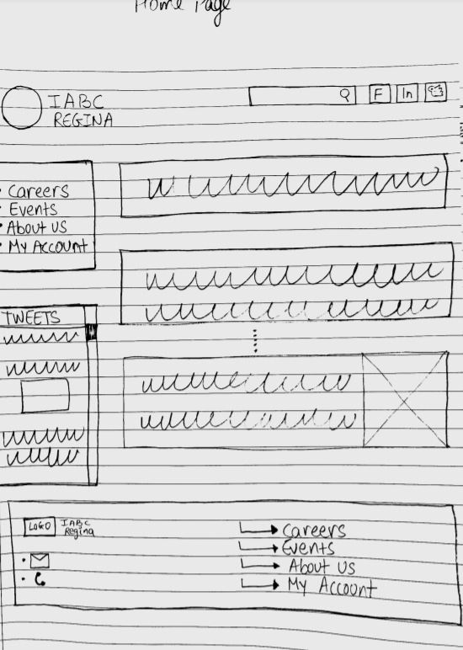

Simple Design
Home Page to Home sweet page
New features like:
Side navigation bar
Easy access
Reorganizing content

Slide 3
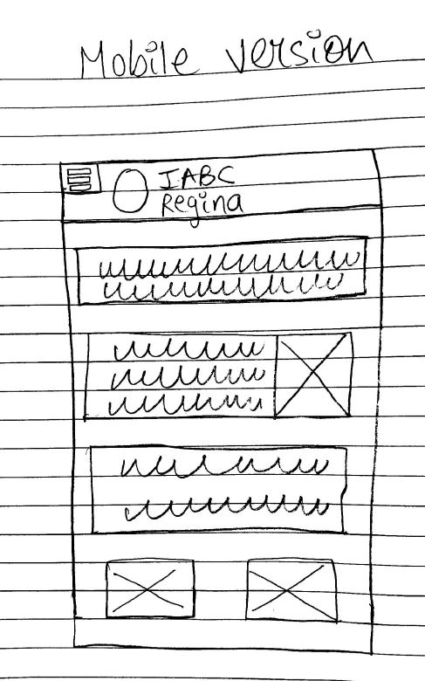

Light Smartphone form
Mobile home page enhanced functionality makes one hand navigation fun.
Developed to satisfy the user Z scanning (corner to corner)

Slide 4
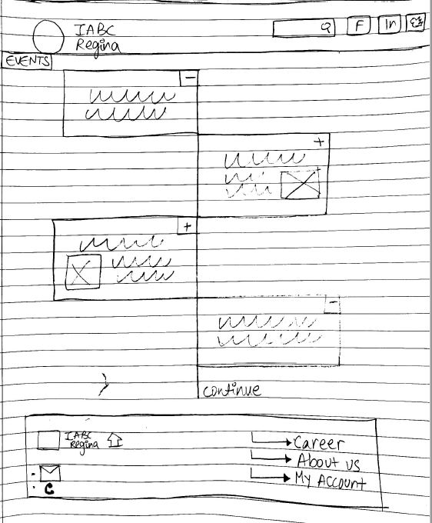

Events
Using timeline map to reduce used space and at the same time accessible

Slide 5
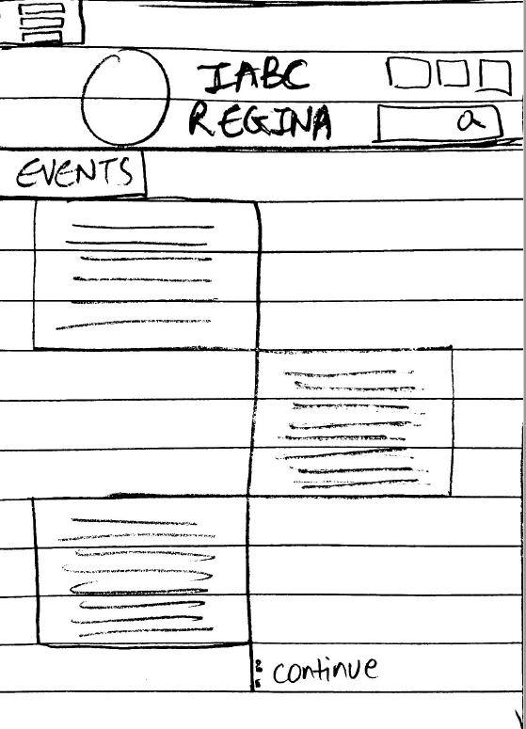

Events
Portable devices version

Slide 6
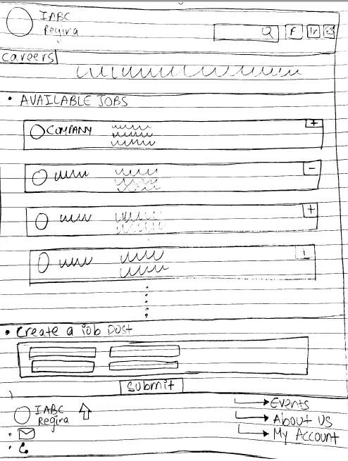

Careers
Functional posting section to share and reduce cluttering

Slide 7
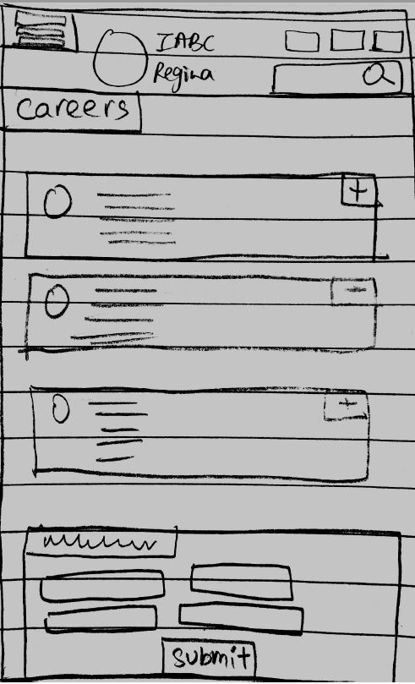

Careers
Easy applying process through a smart device

Slide 8
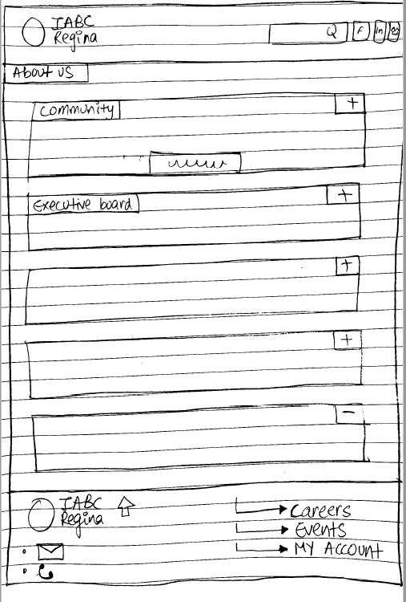


About IABC
Merging contact us & About us to avoid reptation
Chat box needed ?

Slide 9
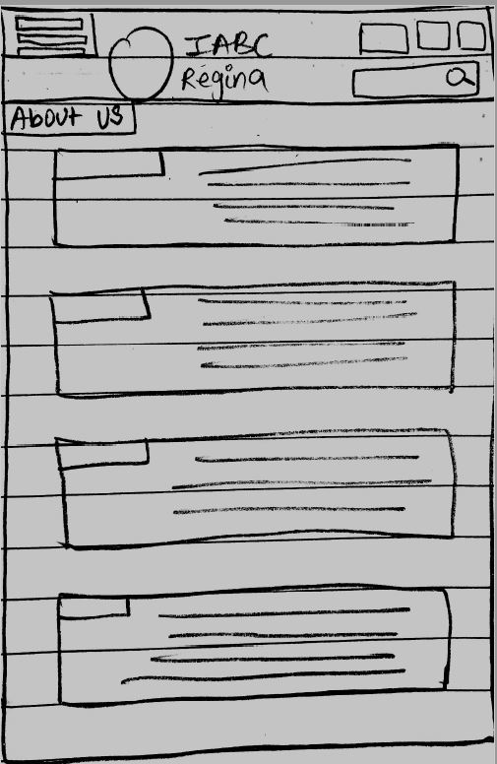


About IABC
A sample without chat box

Slide 10
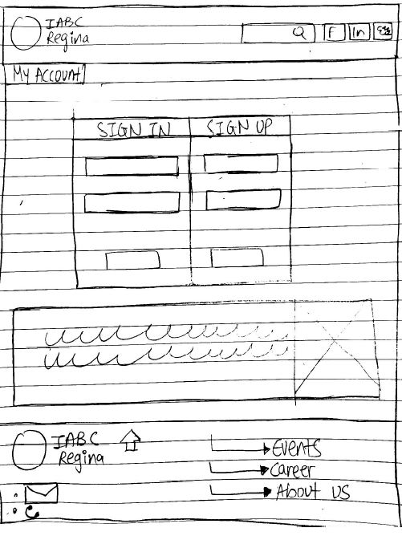

Become Member
This page now looks simple to understand and react with

Slide 11
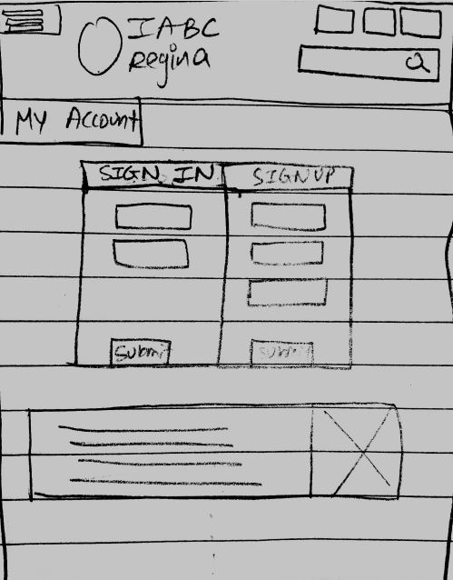
Become Member
Mobile site version

Slide 12

Thank you
Feedback & comments

